Slide 1

COMP90018
Mobile Computing Systems Programming
WEEK 2 – UI, Android Wear OS
Weiwei Jiang
weiwei.jiang@student.unimelb.edu.au

Slide 2
Group
Group formation
  You should be in a group now.
  If not, please send me an email, I will try to find a group for you.

Slide 3
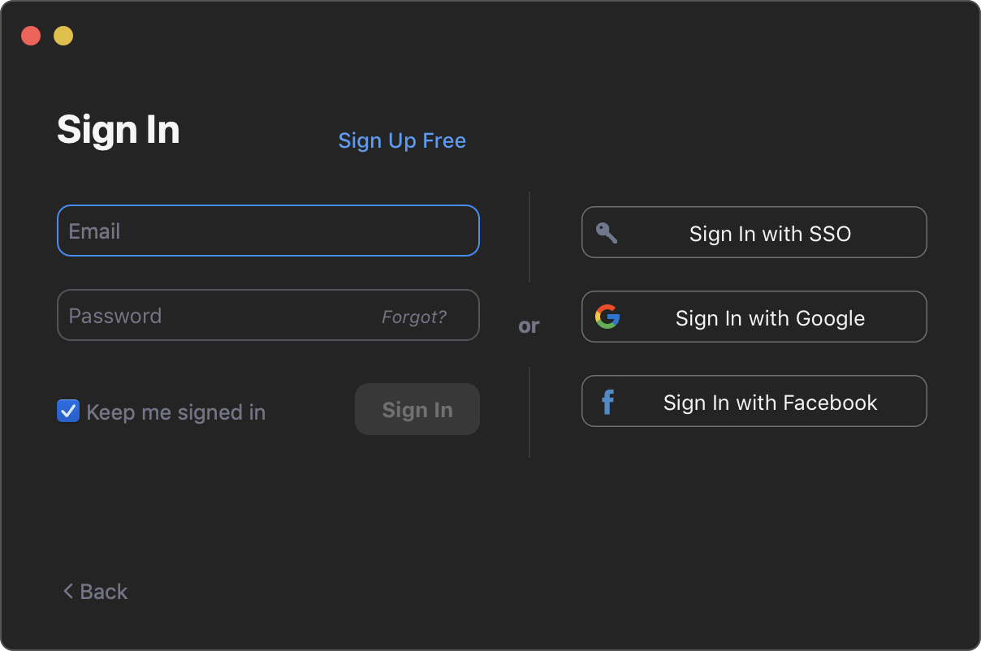
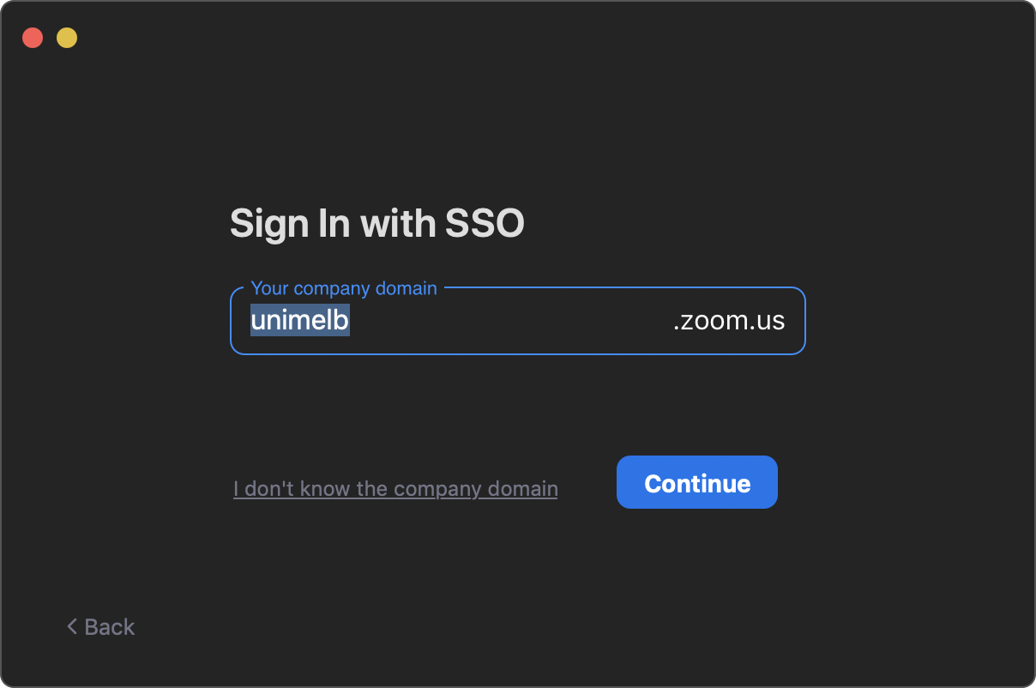
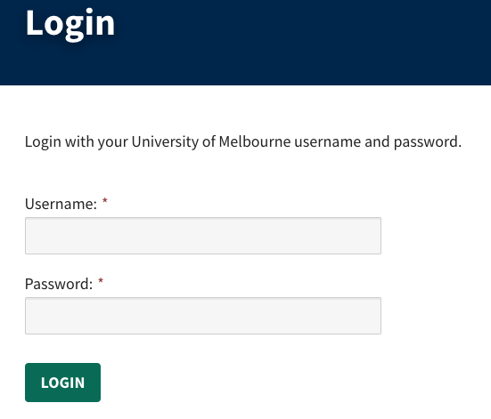
Zoom
1
2
3
Zoom domain for University of Melbourne: unimelb.zoom.us

Slide 4
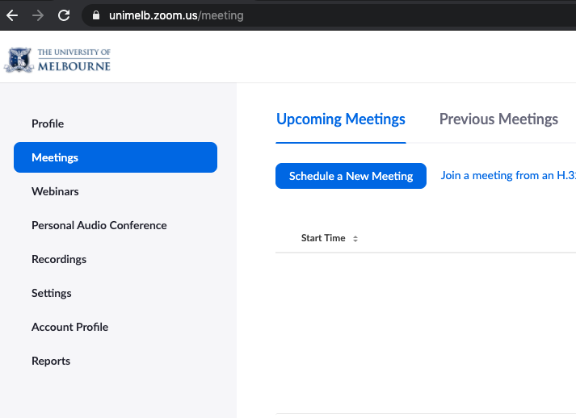
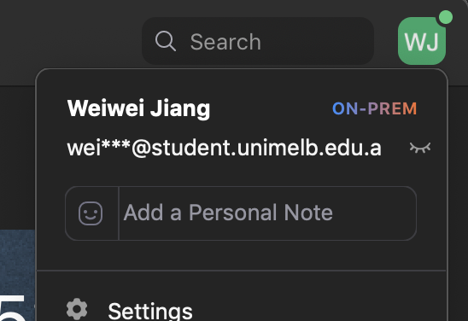
Zoom
4
5

Slide 5
Tips for Group Work
Some tips for your group work
  Spend more time on discussing your topic / tech stack
  Have regular group meeting
    Unimelb students can host zoom meetings on https://www.unimelb.edu.au/zoom
  Consider making a group contract
Tools that may help
  Slack
  Microsoft Team
  GitHub
  etc.

Slide 6
1
User Interface (UI)
2
Android Wear OS
CONTENTS

Slide 7

User Interface
Activity

Slide 8

User Interface
User interface in Android application is everything that the user can see and interact with.
https://developer.android.com/guide/topics/ui

Slide 9
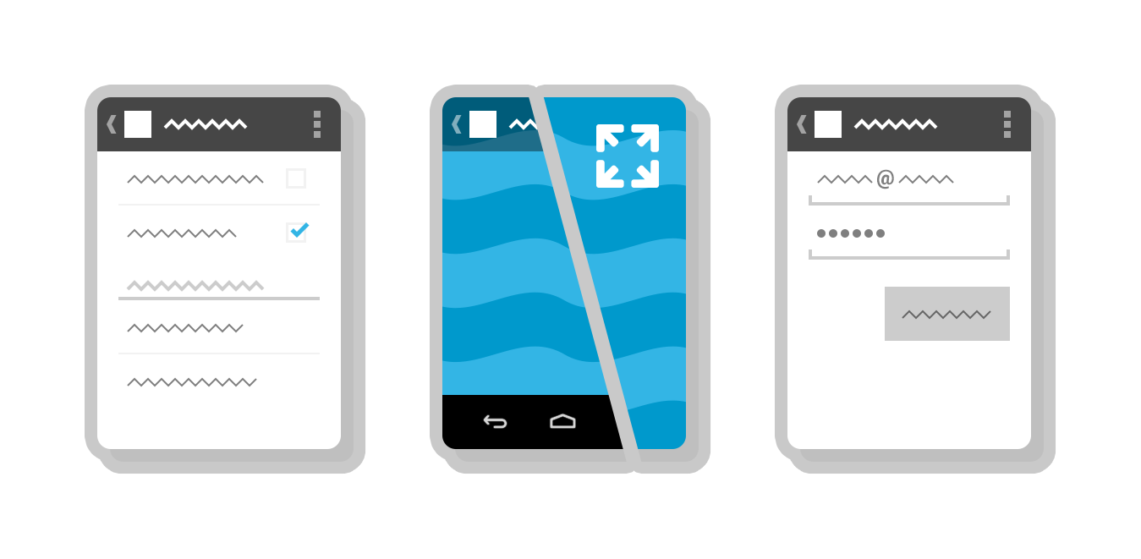
Activity
An activity provides the window in which the app draws its UI.
https://developer.android.com/guide/components/activities/intro-activities

Slide 10
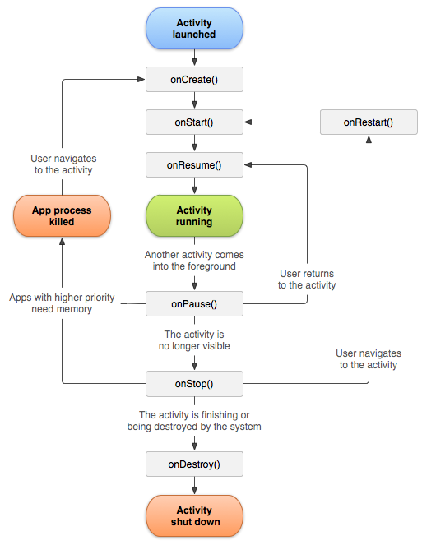
Activity
Unlike programming paradigms in which apps are launched with a main() method, the Android system initiates code in an Activity instance by invoking specific callback methods that correspond to specific stages of its lifecycle.

Slide 11
Activity – onCreate/onDestroy
The entire lifetime of an activity happens between the first call to onCreate(Bundle) through to a single final call to onDestroy().
An activity will do all setup of "global" state in onCreate(), and release all remaining resources in onDestroy().

Slide 12
Activity – onStart/onStop
The visible lifetime of an activity happens between a call to onStart() until a corresponding call to onStop().
During this time the user can see the activity on-screen, though it may not be in the foreground and interacting with the user.

Slide 13
Activity – onResume/onPause
The foreground lifetime of an activity happens between a call to onResume() until a corresponding call to onPause().
During this time the activity is in visible, active and interacting with the user.

Slide 14
User Interface
Fragment

Slide 15
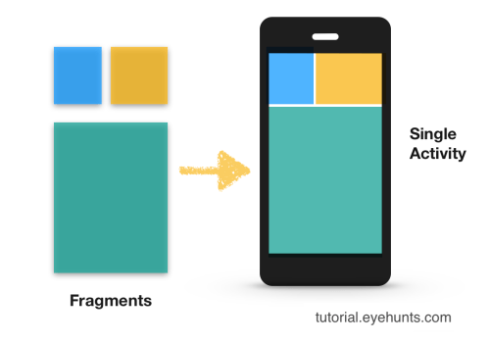
Fragment
A Fragment represents a behaviour or a portion of user interface in a FragmentActivity.
You can combine multiple fragments in a single activity to build a multi-pane UI and reuse a fragment in multiple activities.
https://developer.android.com/guide/components/fragments

Slide 16
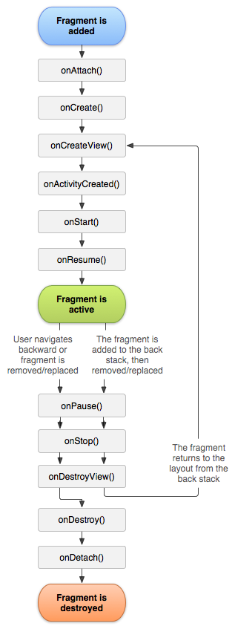
Fragment
You can think of a fragment as a modular section of an activity, which has its own lifecycle, receives its own input events, and which you can add or remove while the activity is running (sort of like a "sub activity" that you can reuse in different activities).

Slide 17
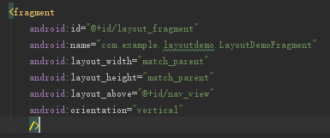
Fragment – adding a Fragment to an Activity
Declare the fragment inside the activity's layout file(XML)
In this case, you can specify layout properties for the fragment as if it were a view.

Slide 18
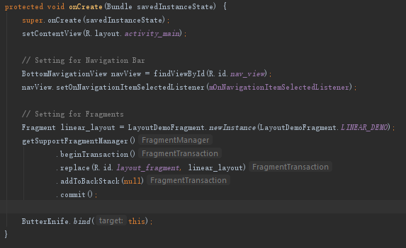
Fragment – adding a Fragment to an Activity
Programmatically add the fragment to an existing ViewGroup
At any time while your activity is running, you can add fragments to your activity layout.

Slide 19
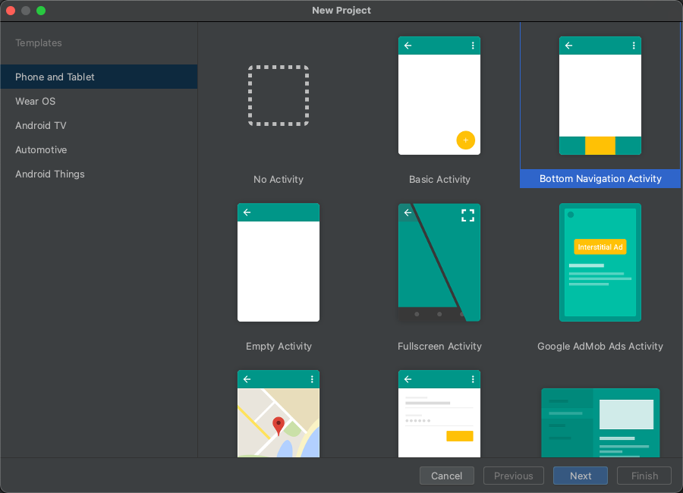
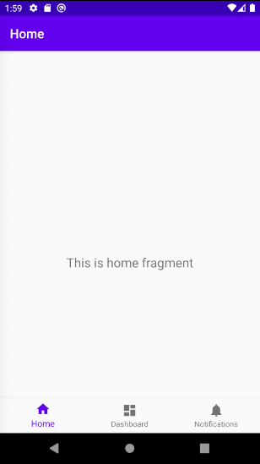
Fragment – template project

Slide 20
User Interface

Slide 21
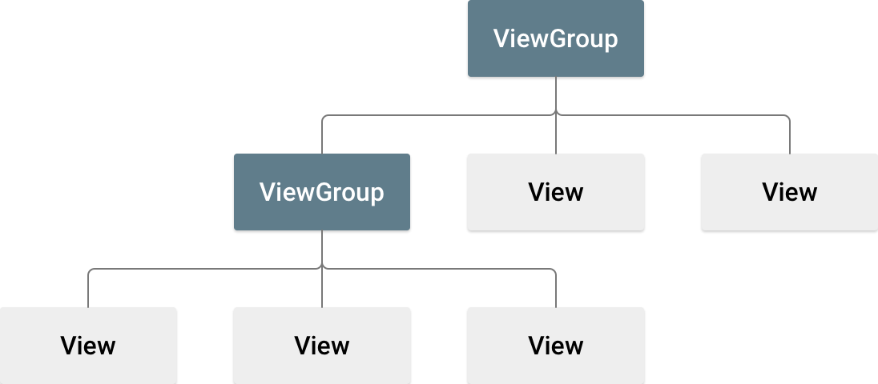
User Interface – Layout
A layout defines the structure for a user interface in your app, such as in an activity.
All elements in the layout are built using a hierarchy of View and ViewGroup objects.

Slide 22
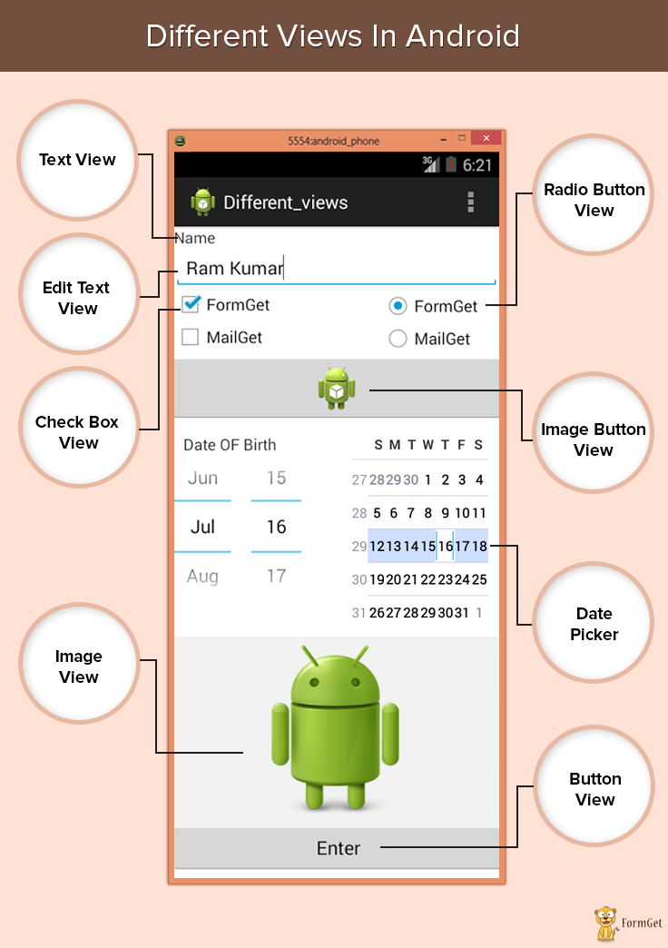
User Interface – View
A View usually draws something the user can see and interact with. The View objects are usually called "widgets" and can be one of many subclasses, such as Button or TextView.
https://developer.android.com/reference/android/view/View.html

Slide 23
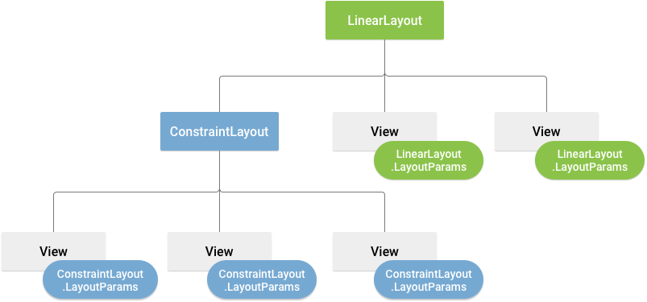
User Interface – ViewGroup
A ViewGroup is an invisible container that defines the layout structure for View and other ViewGroup objects.
https://developer.android.com/reference/android/view/ViewGroup.html

Slide 24
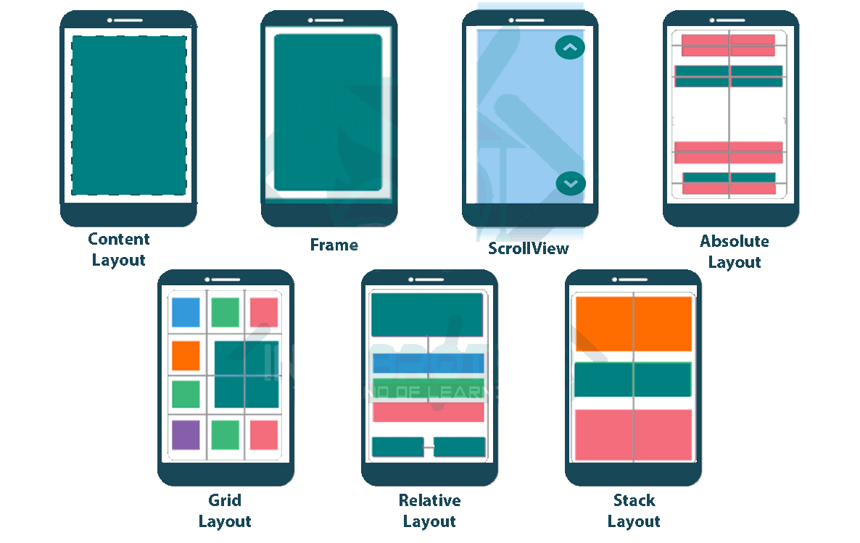
User Interface – ViewGroup
The ViewGroup objects are usually called "layouts" can be one of many types that provide a different layout structure, such as LinearLayout or ConstraintLayout .

Slide 25
User Interface
Declare Layouts

Slide 26
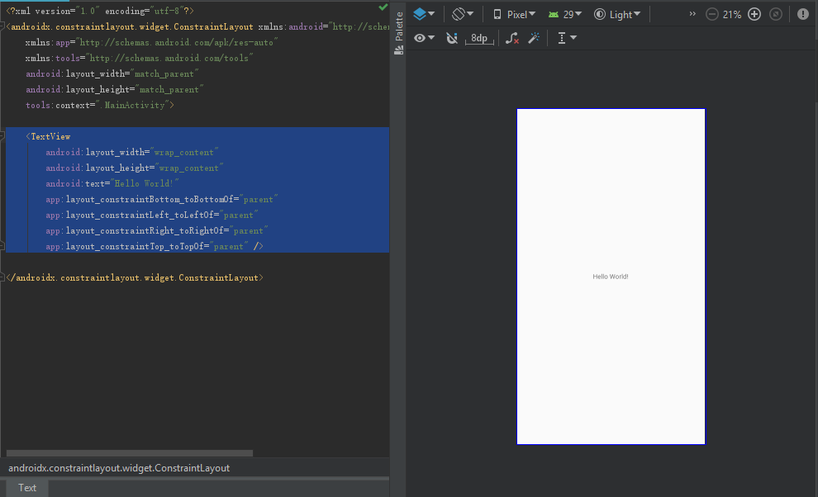
Declare a layout (XML)
Declare UI elements in XML
Android provides a straightforward XML vocabulary that corresponds to the View classes and subclasses, such as those for widgets and layouts.

Slide 27
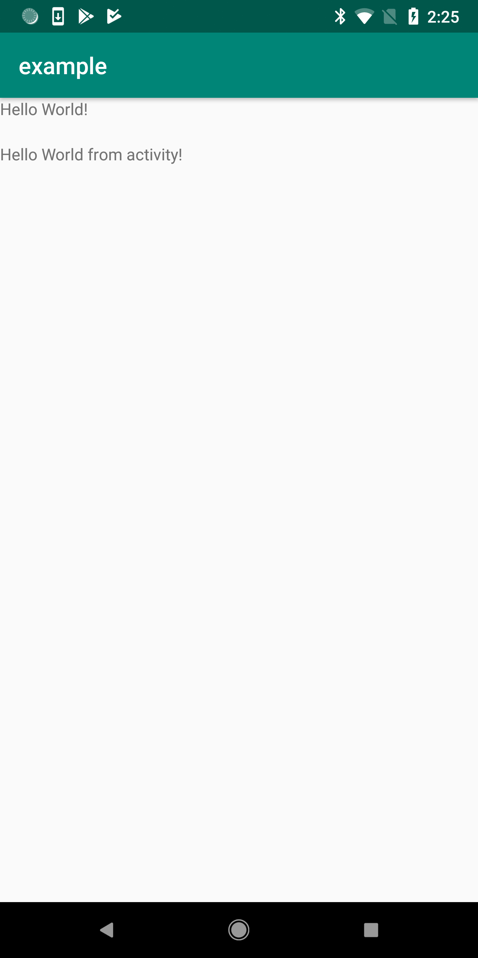
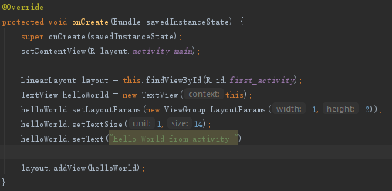
Declare a layout (Runtime)
Instantiate layout elements at runtime
Your app can create View and ViewGroup objects (and manipulate their properties) programmatically.

Slide 28
User Interface
Linear Layout and Relative Layout

Slide 29

Linear Layout
Linear Layout
A layout that organizes its children into a single horizontal or vertical row.
It creates a scrollbar if the length of the window exceeds the length of the screen.
https://developer.android.com/guide/topics/ui/layout/linear

Slide 30
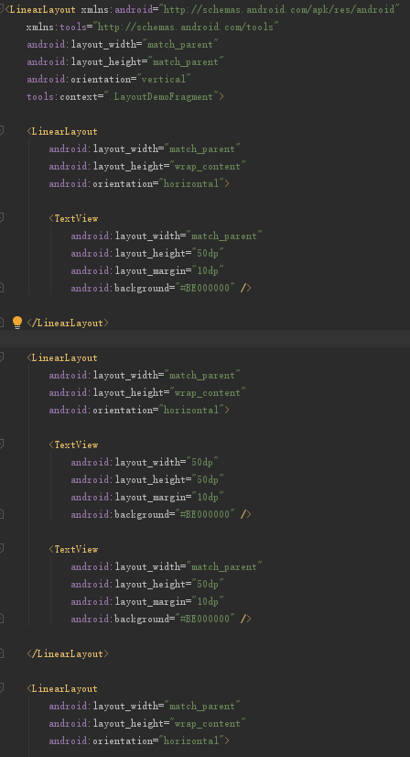
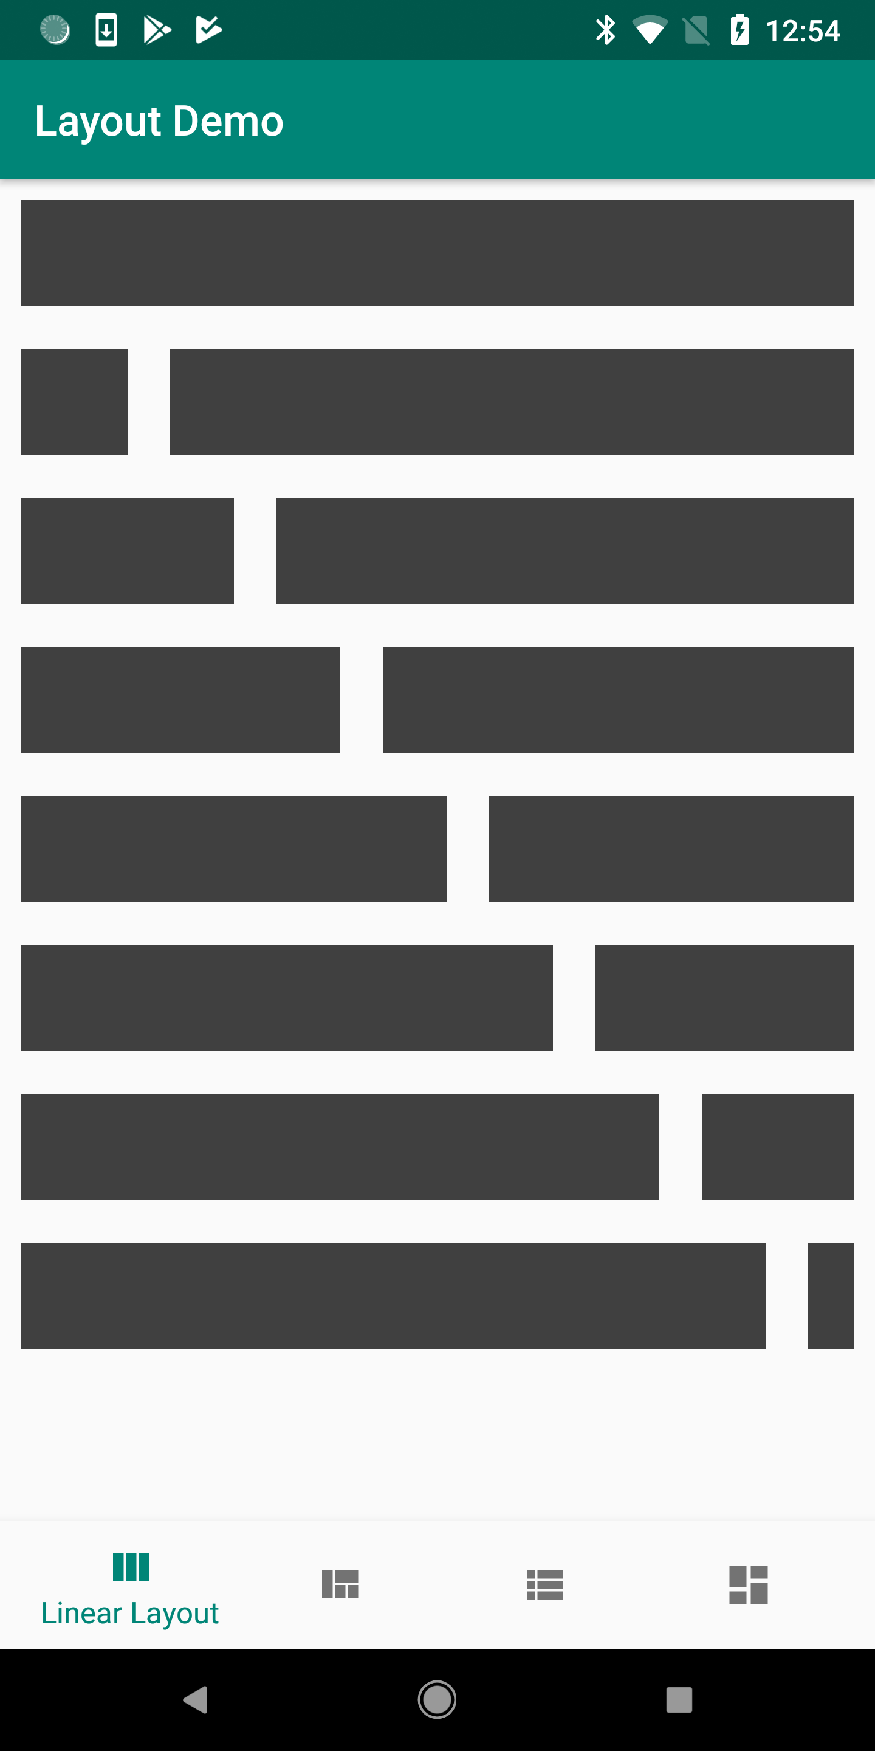
Linear Layout (Code)
fragment_layout_demo_linear.xml

Slide 31

Relative Layout
Relative Layout
Enables you to specify the location of child objects relative to each other (child A to the left of child B) or to the parent (aligned to the top of the parent).
https://developer.android.com/guide/topics/ui/layout/relative

Slide 32
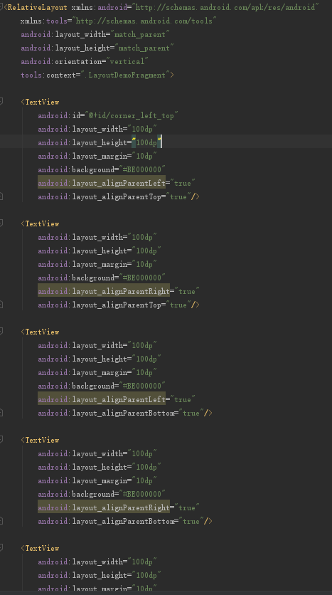
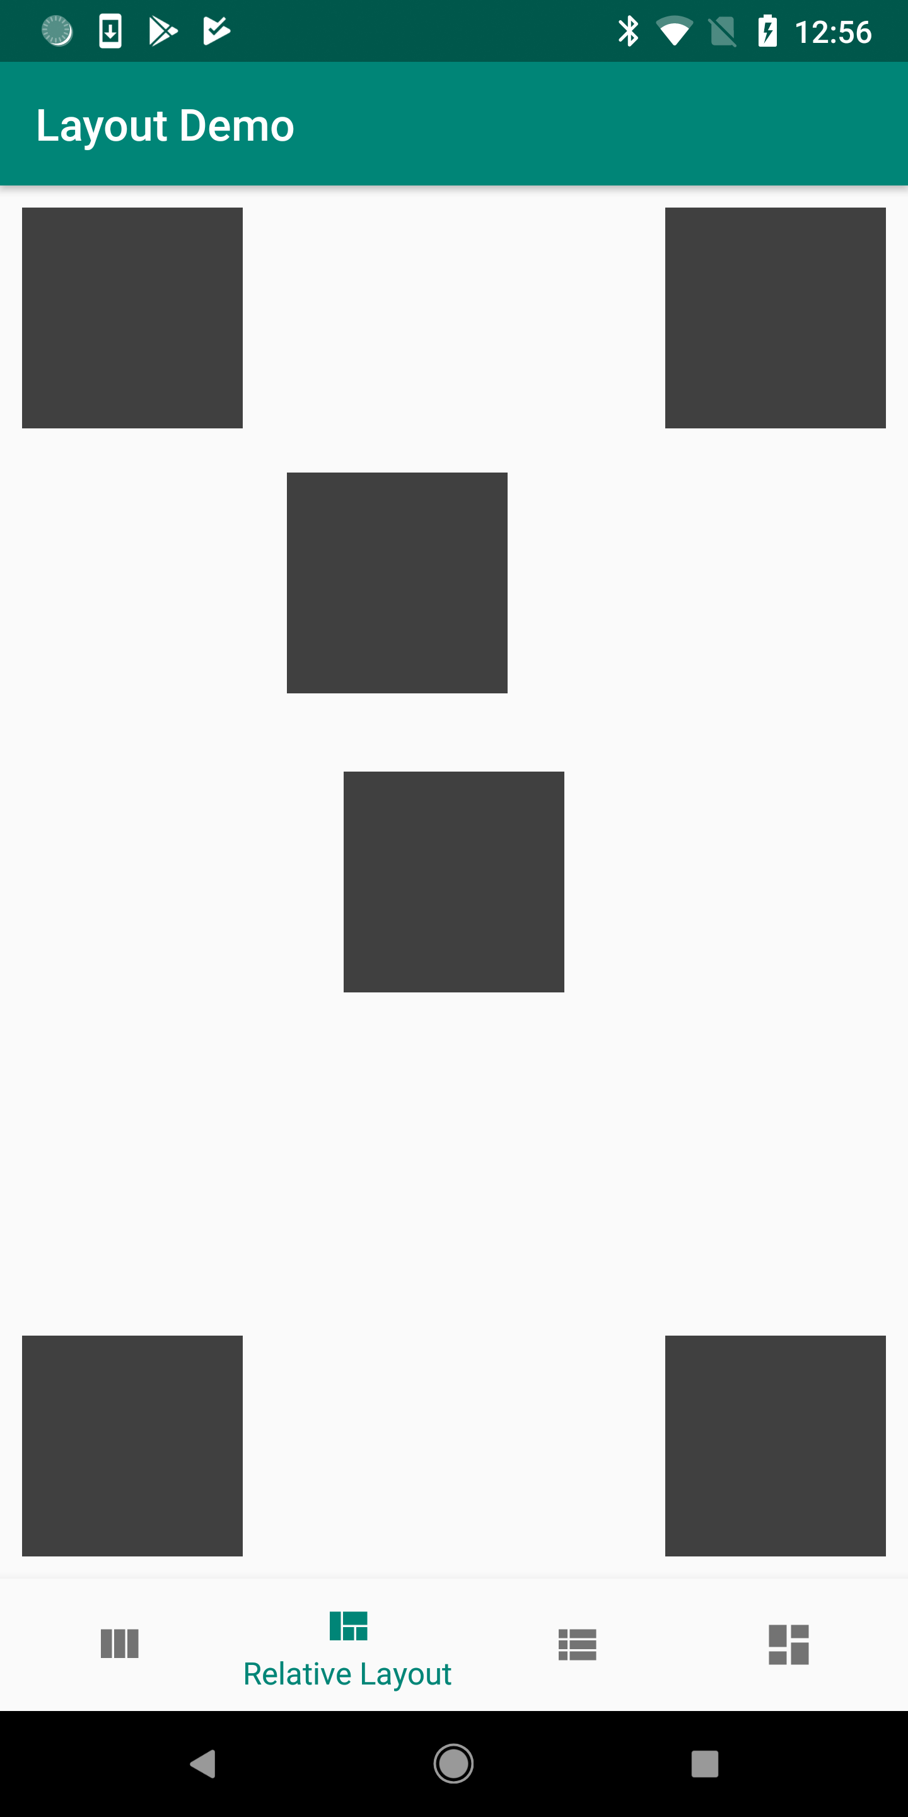
Relative Layout (Code)
fragment_layout_demo_relative.xml

Slide 33
User Interface
- Connecting Data with Layout: Adapter

Slide 34


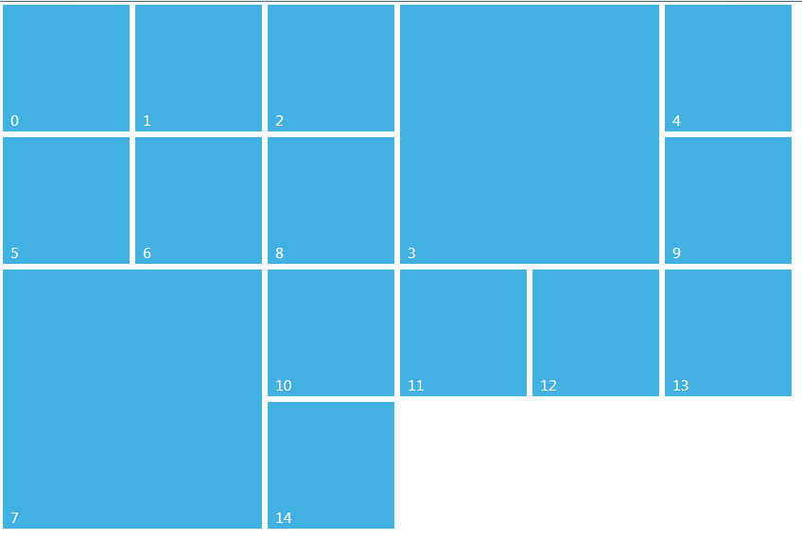
Adapter
What is the adapter?
The Adapter behaves as a middleman between the data source and the AdapterView layout:
- Retrieves the data (from a source such as an array or a database query)
- Converts each entry into a view that can be added into the AdapterView layout.
List View
Grid View
......
Recycler View

Slide 35
Adapter
Why do we need an adapter?
When the content for the layout is dynamic or not pre-determined, you can use a layout that subclasses AdapterView to populate the layout with views at runtime.
A subclass of the AdapterView class uses an Adapter to bind data to its layout.
List View
Grid View
......
Recycler View

Slide 36
User Interface
List View
(Displays a scrolling single column list)

Slide 37
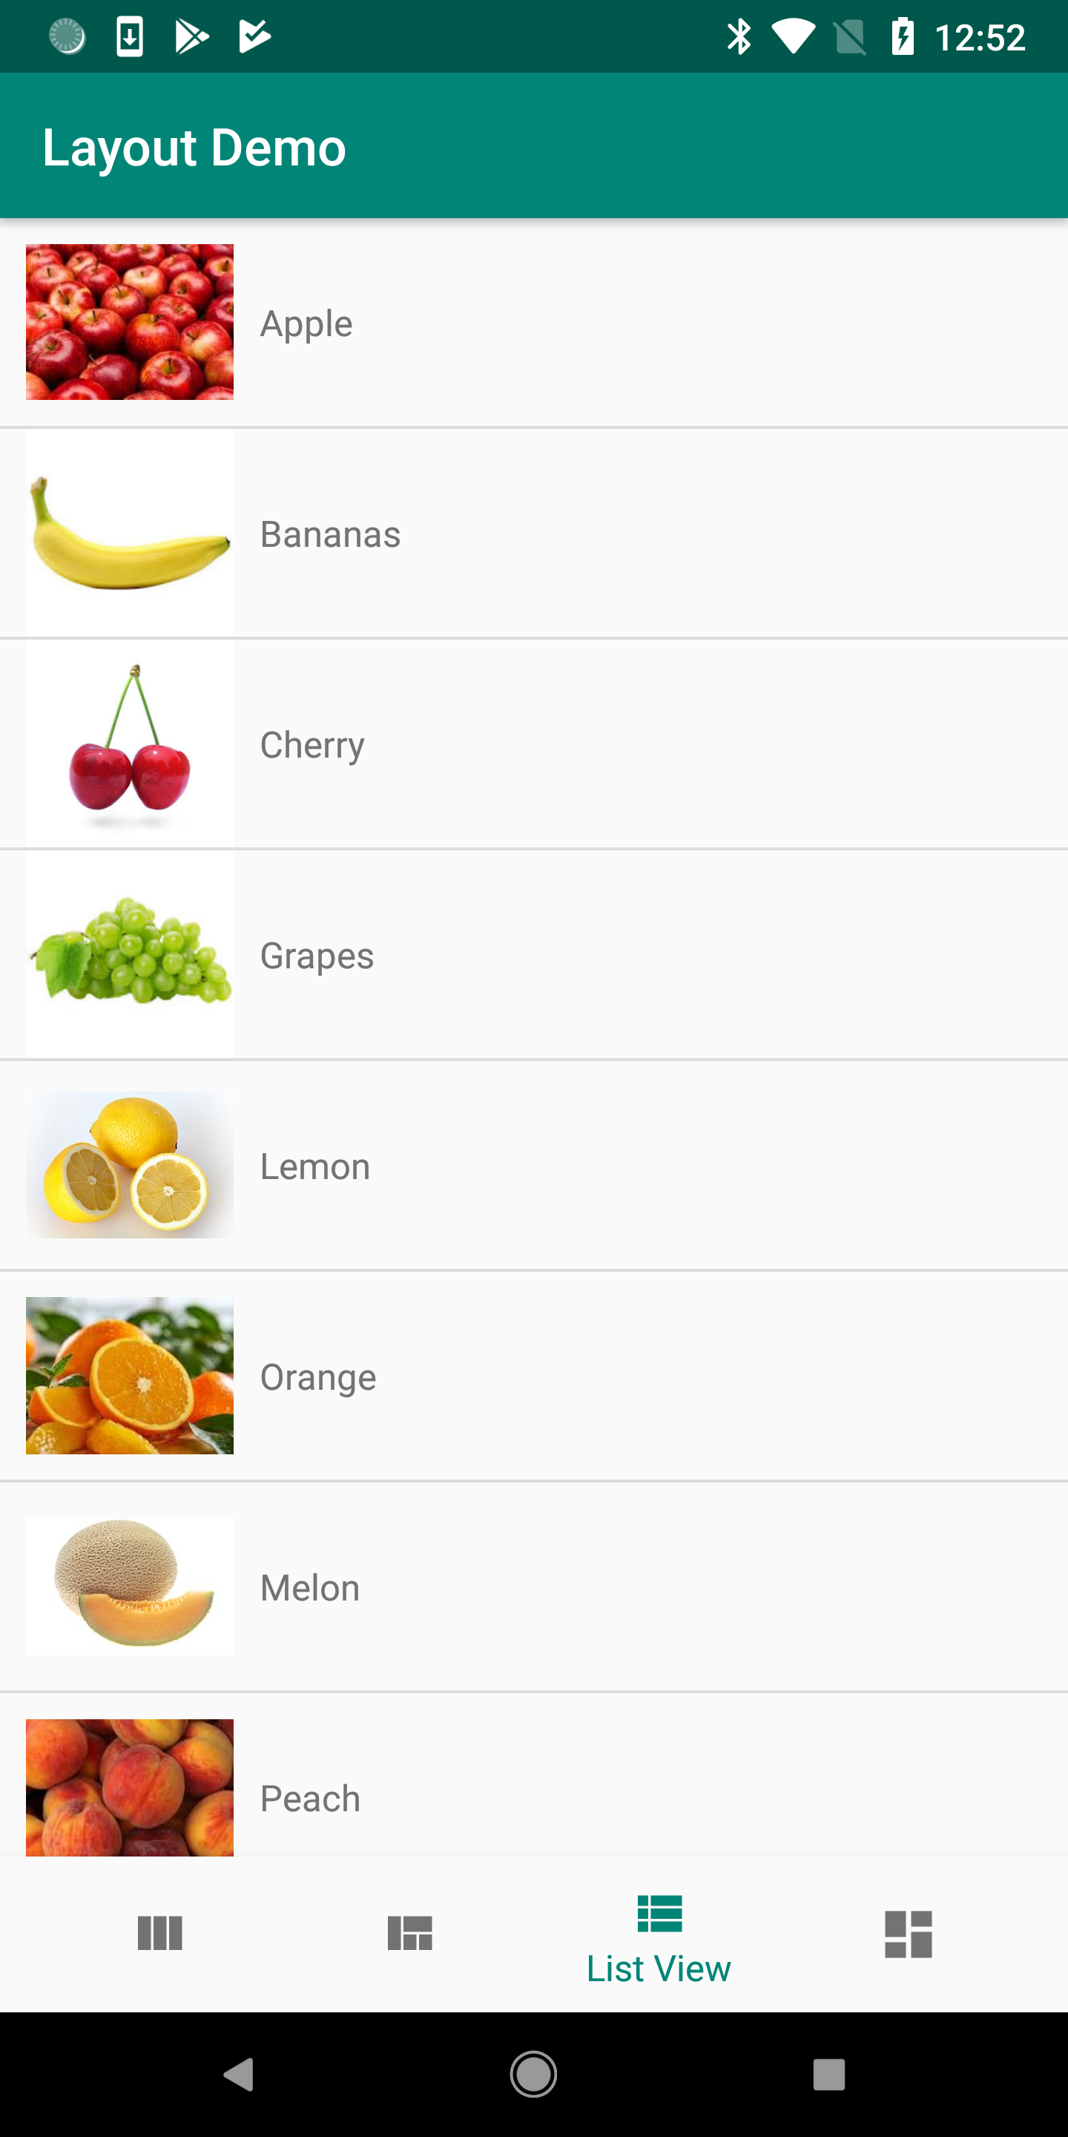
List View
To create a List View:
Declare ListView in layout (XML)
Create Object
Create Adapter and ViewHolder
Bind Adapter with ListView in the Activity
https://developer.android.com/reference/android/widget/ListView

Slide 38
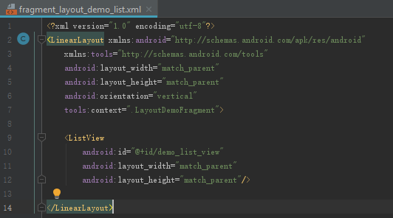
List View
Declare ListView in layout (XML)
Create Object
Create Adapter and ViewHolder
Bind Adapter with ListView in the Activity
fragment_layout_demo_list.xml

Slide 39
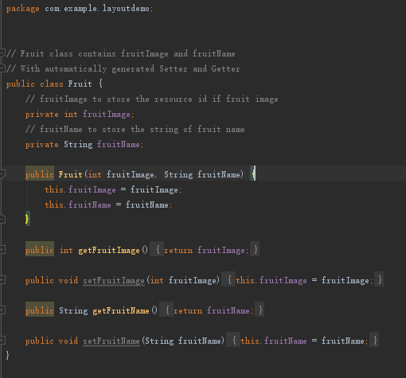
List View
Declare ListView in layout (XML)
Create Object (Java Class)
Create Adapter and ViewHolder
Bind Adapter with ListView in the Activity
Fruit.java

Slide 40
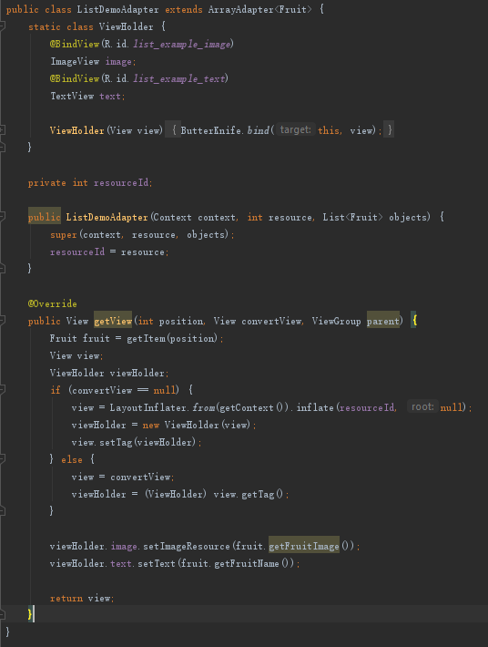
List View
Declare ListView in layout (XML)
Create Object
Create Adapter and ViewHolder
Bind Adapter with ListView in the Activity
ListDemoAdapter.java

Slide 41
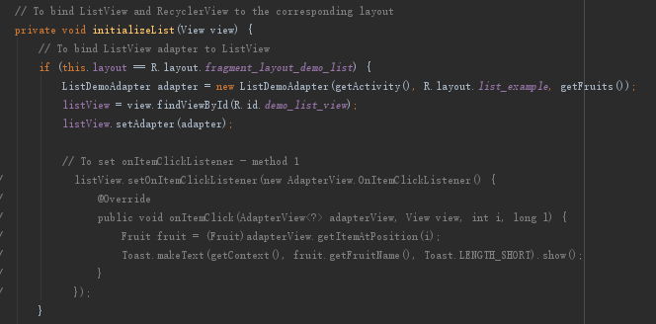
List View
Declare ListView in layout (XML)
Create Object
Create Adapter and ViewHolder
Bind Adapter with ListView in the Activity
LayoutFragmentDemo.java

Slide 42
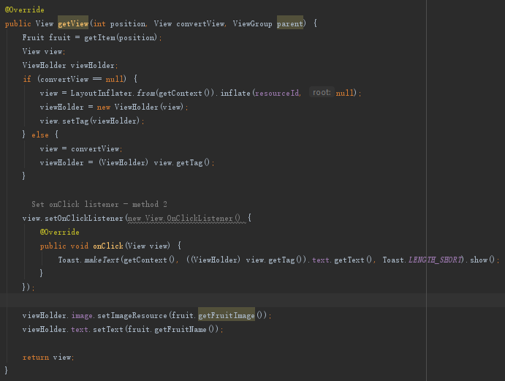
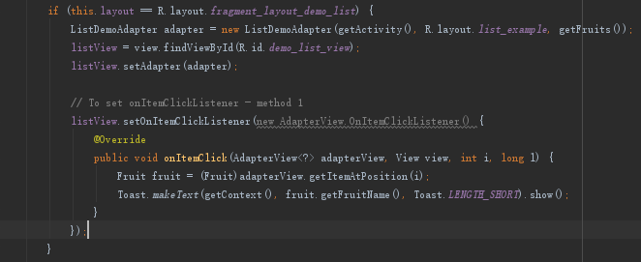
List View – Listeners when Clicking Items
LayoutFragmentDemo.java
ListDemoAdapter.java

Slide 43
User Interface
Recycler View
(A more advanced and flexible version of ListView)

Slide 44
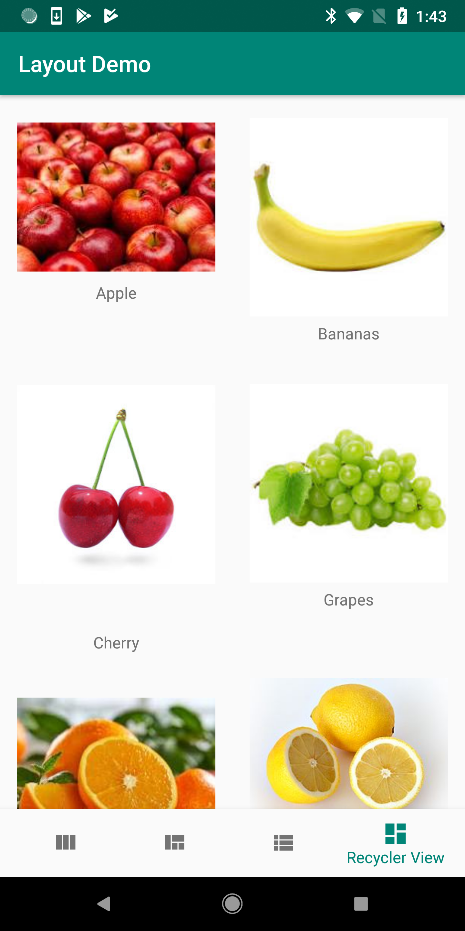
Recycler View
To create a Recycler View:
Declare RecyclerView in layout (XML)
Create Object
Create Adapter and ViewHolder
Bind Adapter with RecyclerView in the Activity
https://developer.android.com/guide/topics/ui/layout/recyclerview

Slide 45
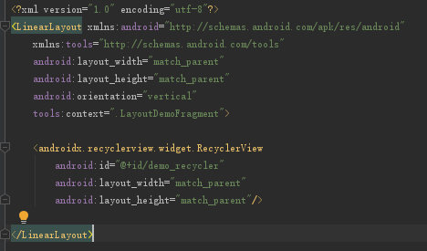
Recycler View
Declare RecyclerView in layout (XML)
Create Object
Create Adapter and ViewHolder
Bind Adapter with RecyclerView in the Activity
fragment_layout_demo_recycler.xml

Slide 46
Recycler View
Declare RecyclerView in layout (XML)
Create Object
Create Adapter and ViewHolder
Bind Adapter with RecyclerView in the Activity
Fruit.java

Slide 47
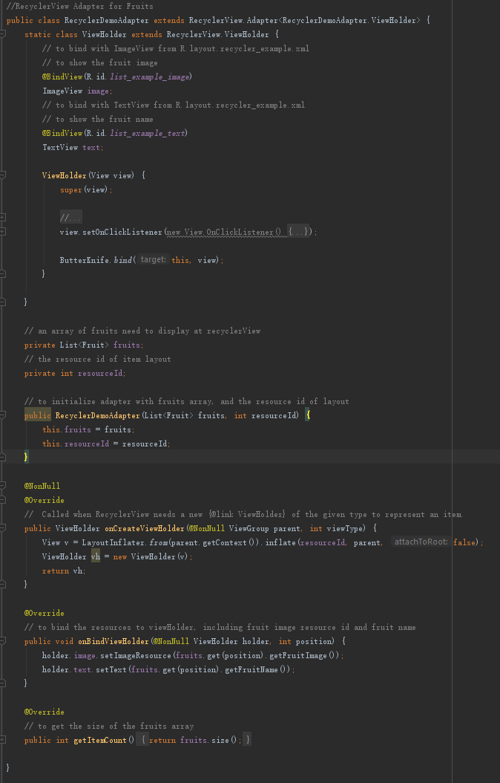
Recycler View
Declare RecyclerView in layout (XML)
Create Object
Create Adapter and ViewHolder
Bind Adapter with RecyclerView in the Activity
RecyclerDemoAdapter.java

Slide 48
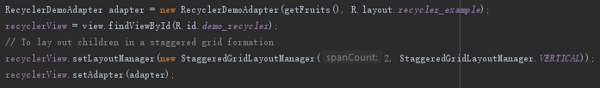
Recycler View
Declare RecyclerView in layout (XML)
Create Object
Create Adapter and ViewHolder
Bind Adapter with RecyclerView in the Activity
LayoutDemoFragment.java

Slide 49
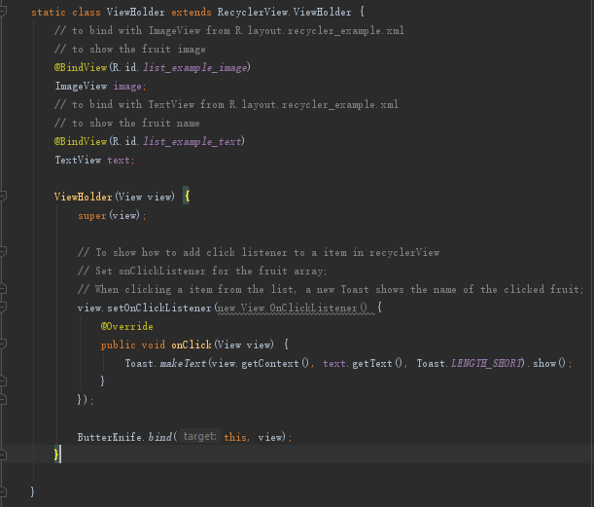
Recycler View – Listener when Clicking Items
RecyclerDemoAdapter.java

Slide 50
Android
Wear OS
(for Reading)

Slide 51
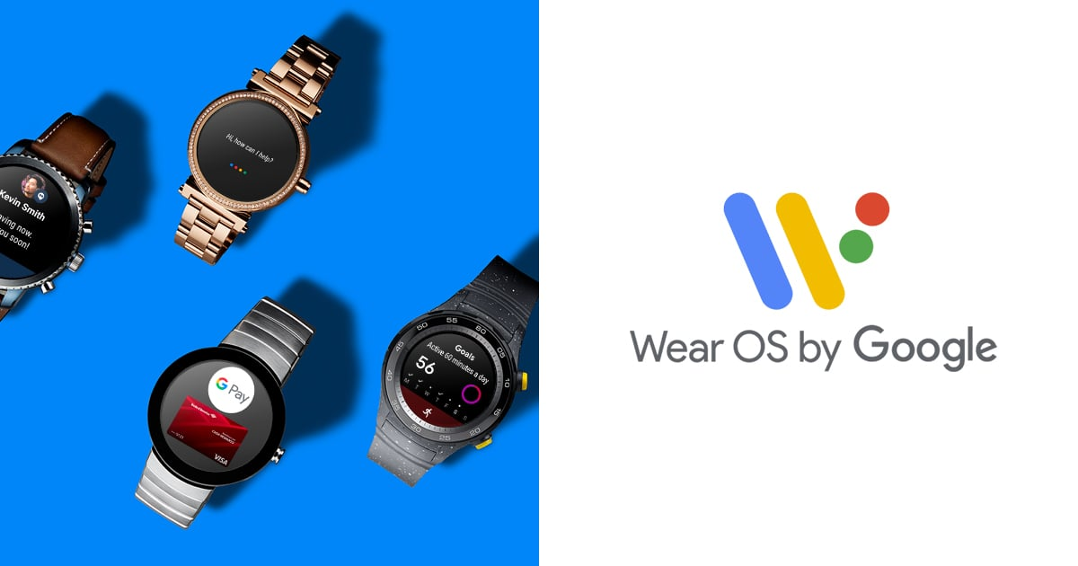
Android Wear OS
Wear OS, also known as Wear OS by Google and previously called Android Wear, is a version of Google's Android operating system designed for smartwatches and other wearables.
https://developer.android.com/training/wearables

Slide 52
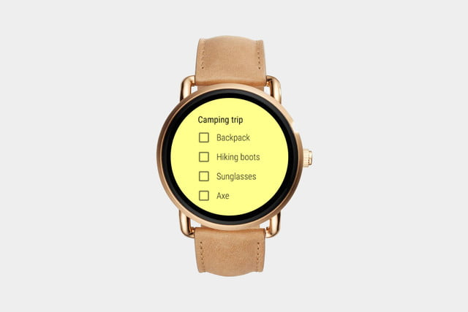
Android Wear OS – Applications
GOOGLE KEEP
Keep is easily note-taking apps, which is designed for quick reminders and shopping lists

Slide 53
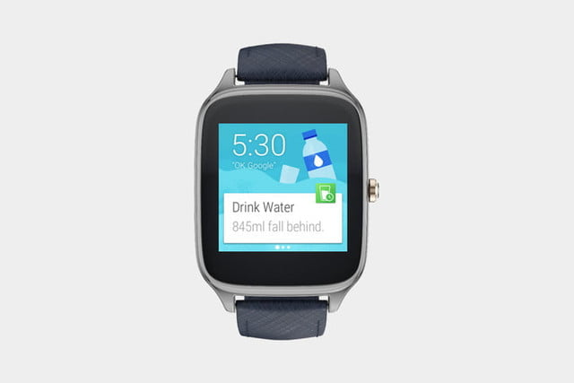
Android Wear OS – Applications
WATER DRINK REMINDER
The app knows how much you need to drink at regular intervals throughout the day.

Slide 54
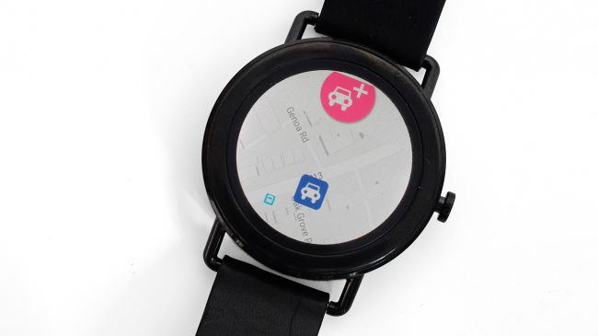
Android Wear OS – Applications
ParKing
ParKing lets you record where you parked your car.

Slide 55
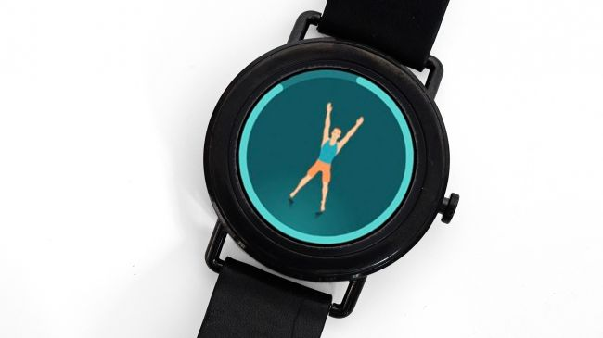
Android Wear OS – Applications
Seven Minute Workout
Seven Minute Workout is a quick, neat way to get a guided workout before you go to work.

Slide 56
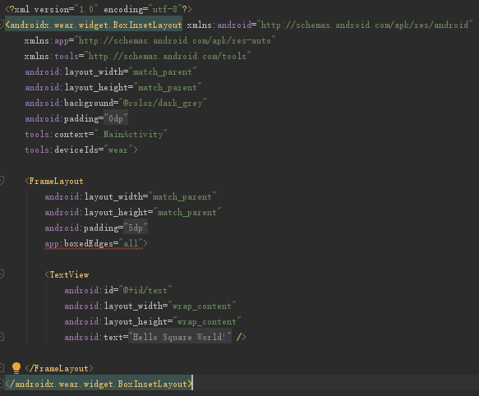
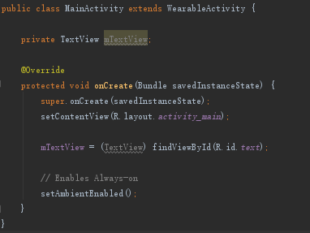
Android Wear OS – Source Code

Slide 57
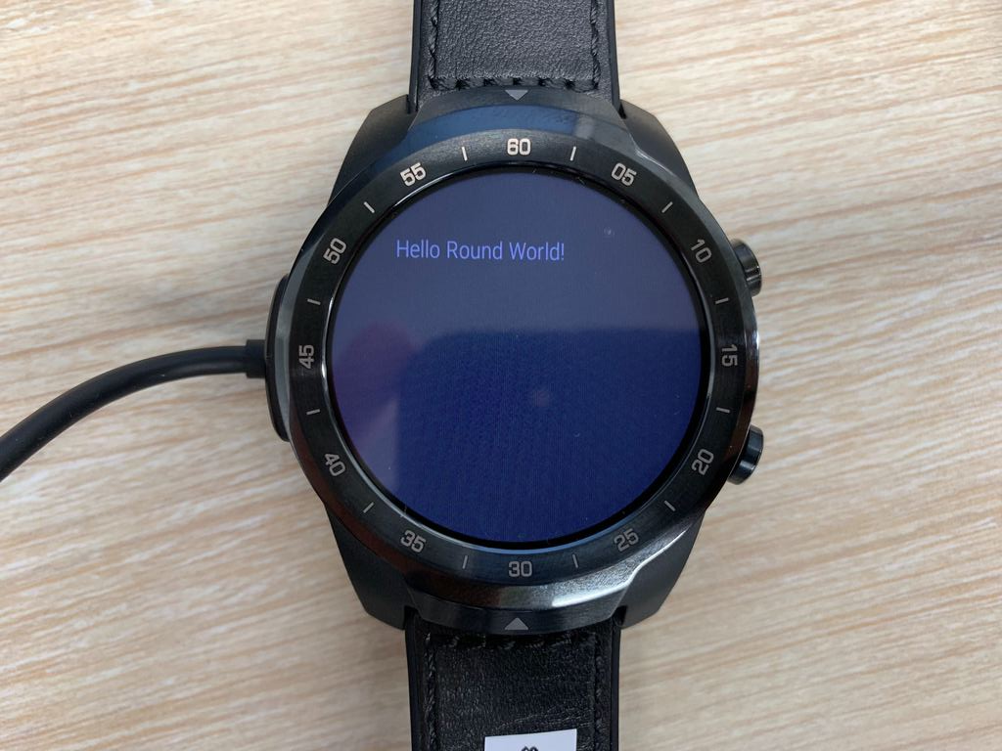
Android Wear OS – Demonstration

Slide 58
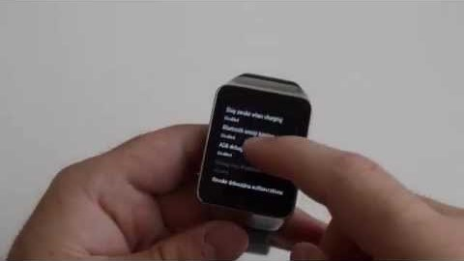
Android Wear OS – Debugging mode
Enable adb debugging on the watch:
Open the Settings menu on the watch.
Scroll to the bottom of the menu. If no Developer options item is provided, tap System and then About.
Tap the build number 7 times.
From the Settings menu, tap Developer options.
Enable ADB debugging.
https://developer.android.com/training/wearables/apps/creating

Slide 59
If you come early for next tutorial,
please re-join the zoom meeting after this call ends.

